Slide 1

Welcome
Notes:
Topic: Performance Statements
Time: 30 minutes
Purpose of training evolution: Sailors will explore the concept of self-talk and performance statements.
Expected outcome of training evolution: Sailors will learn how to develop and use appropriate performance statements.
Safety: Inform Sailors of safety hazards in the training environment. For some topics, Sailors should be informed if there is a designated person to talk to if the Sailor feels compelled to leave the training.
Facilitator Actions:
Display slide.
Greet Sailors.
Introduce yourself and give any background on yourself that might be of interest.
Establish credibility.
Facilitator Instructions:
The slide deck acts as a guide to present a facilitated discussion that may include activities.
Best practice: Use the slide to develop interest in the subject matter. Do not read the slides word for word. The Sailors should be able read the text and understand the messaging presented in the graphics.
Facilitator notes are available for each slide to help the Facilitator deliver the topic.
Best practice: Use the Slide Show view to ensure the Facilitator notes are viewable.
The Facilitator notes are divided into general instructions for Facilitator Actions (mechanics of facilitation) and the Facilitator Content (Inform, Discuss, Perform, and Reference).
Best practice for Inform: Present facts, concepts, and procedures. Depending on the subject matter, these may be written as suggested talking points or scripted material (denoted by quotation marks).
Best practice for Discuss: Conduct large-group question and answer sessions or large-group, Facilitator-led activities. Depending on the subject matter, these may be written as questions with expected answers or scripted activities.
Best practice for Perform: Facilitate small-group, scenario-based or procedural activities. Depending on the subject matter, these may be written with specific actions the Sailors will take or general ways for the Facilitator to monitor the activities. The Facilitator will be provided with expected outcomes to ensure Sailors leave training with correct information.
Best practice for Reference: This is for Facilitator use only.

Slide 2
Warrior Toughness
Introduction
MIND • BODY • SPIRIT
Performance Statements
Notes:
Facilitator Actions:
Display slide.
Introduce topic.
Let Sailors know that they can leave the discussion if they have to for their own well-being.
Ensure that misinformation is corrected immediately.
Monitor the discussions of the Sailors throughout the training event.
Facilitator Content:
To build Warrior Toughness, Sailors will explore the concept of self-talk and performance statements. Sailors will learn how to develop and use appropriate performance statements.

Slide 3
Learning Objective
Use performance statements to increase motivation and improve self-talk.
Notes:
Facilitator Actions:
Display slide.
Neither Sailors nor Facilitator should read the objective out loud.
Facilitator Content: N/A

Slide 4
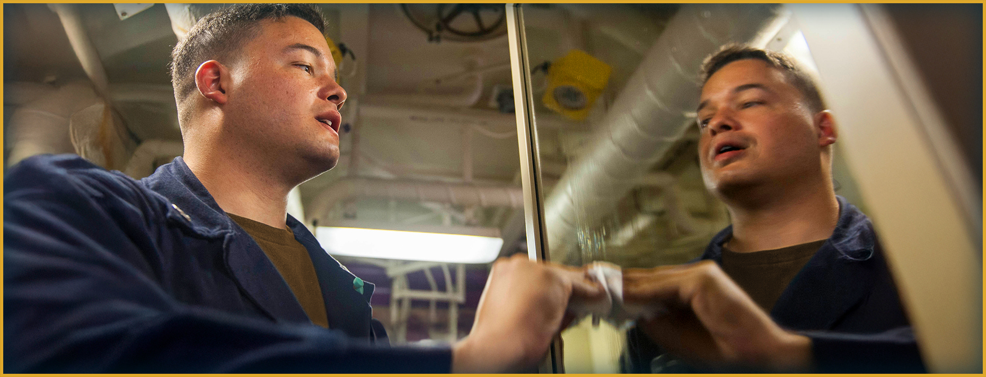
Performance Statements
What is a performance statement?
Notes:
Facilitator Actions:
Display slide.
Discuss how graphic relates to topic.
Monitor the discussions of the Sailors.
Facilitator Content:
Inform:
A performance statement is the words you say to yourself to help you perform at your peak.
Performance statements should be:
Brief: It should be short and easy to recall (like a mantra), even when you are mentally or physically exhausted. For example, “Just do it.”
Instructive: Focus on what you want to do rather than what to avoid. Clear, goal-oriented phrases like “keep moving” work better than “don’t stop.”
Realistic: The statement should feel achievable, especially under stress. If it is too ambitious, it will not be effective.
Helpful: Its purpose is to redirect your thinking in a useful way. It does not need to sound positive, only to motivate or support you personally.
Discuss:
What is a performance statement?
What should performance statements be?

Slide 5
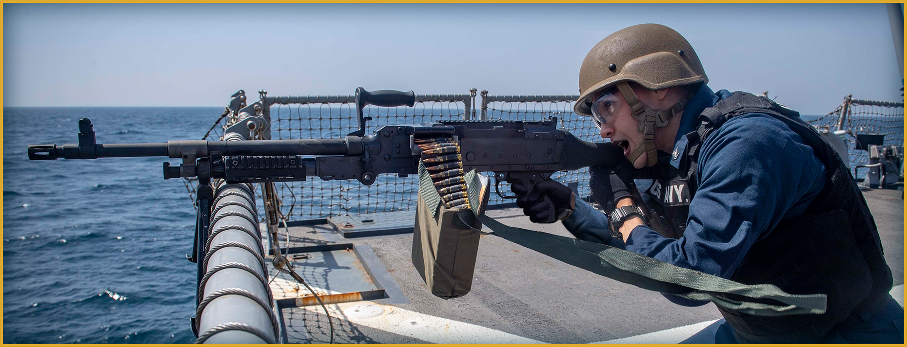
Performance Statements Use
What are some examples of performance statements Sailors have used?
Notes:
Facilitator Actions:
Display slide.
Discuss how graphic relates to topic.
Monitor the discussions of the Sailors.
Facilitator Content:
Inform:
Performance statements can be specific or generalized.
Discuss:
What are some examples of performance statements Sailors have used?
Think of a high stress event in your life. What words did you say to yourself to help you succeed in that particular task?
Use phrases like “I am prepared,” “I can do this,” and “I will perform.”
Were the performance statements successful or unsuccessful?
Situation
Performance statement(s) used
Outcome

Slide 6
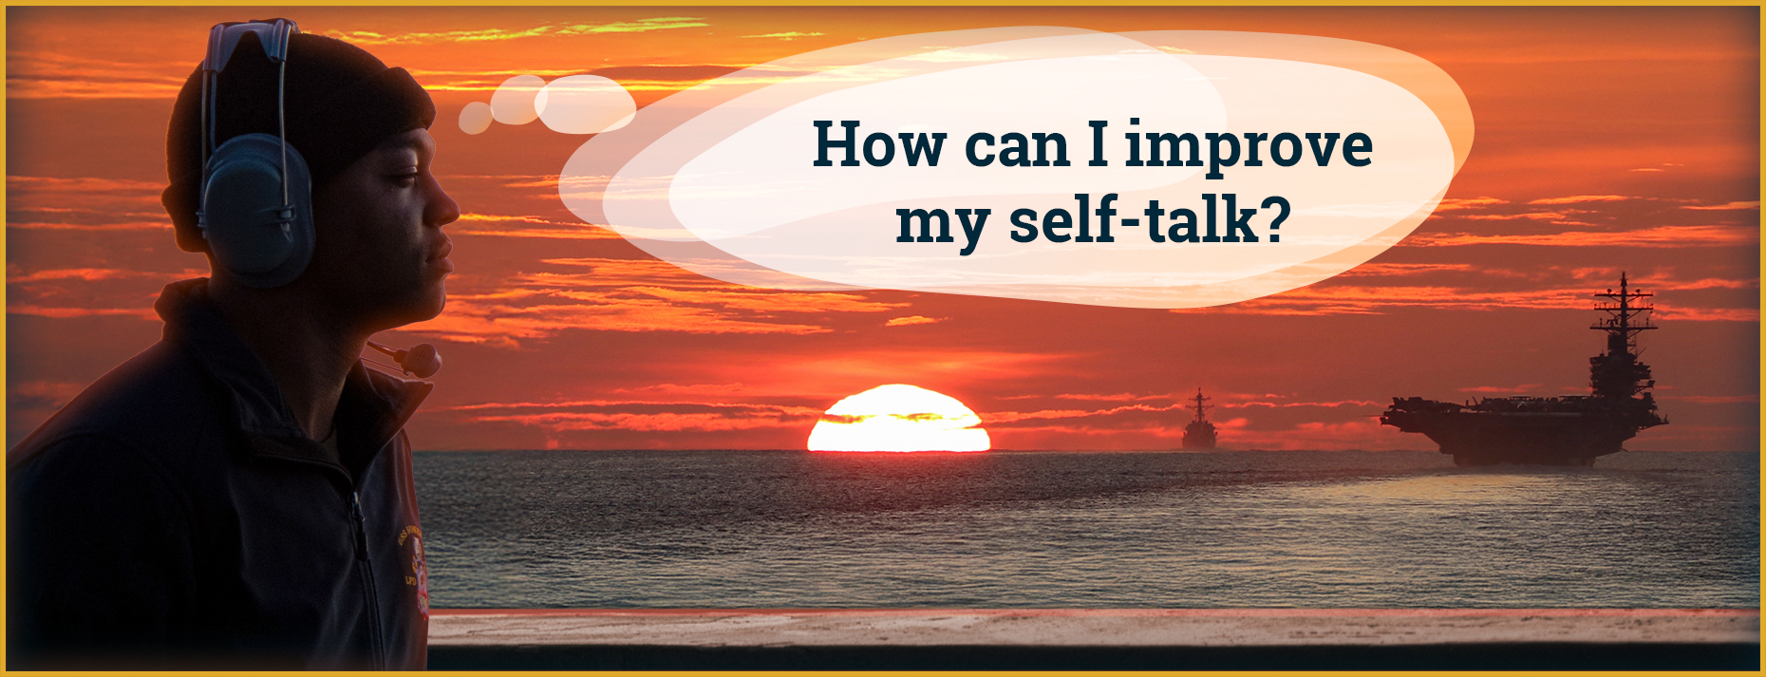
Self-Talk
Self-talk is the way you talk to yourself, out loud, or in your head.
Notes:
Facilitator Actions:
Display slide.
Discuss how graphic relates to topic.
Monitor the discussions of the Sailors.
Facilitator Content:
Inform:
Self-talk is the way you talk to yourself, out loud, or in your head.
Discuss:
Self-talk affects individual performance and can be improved.
Most people are unaware of the impact of their thoughts.
Building awareness of self-talk allows you to:
Intervene when your self-talk negatively impacts your performance.
Utilize self-talk to improve your performance.
How can you improve your awareness of self-talk?
Practice mindfulness.
Examine how thoughts affect your mood and behavior.
Look for patterns.
Perform:
Have Sailors execute examples of self-talk.

Slide 7
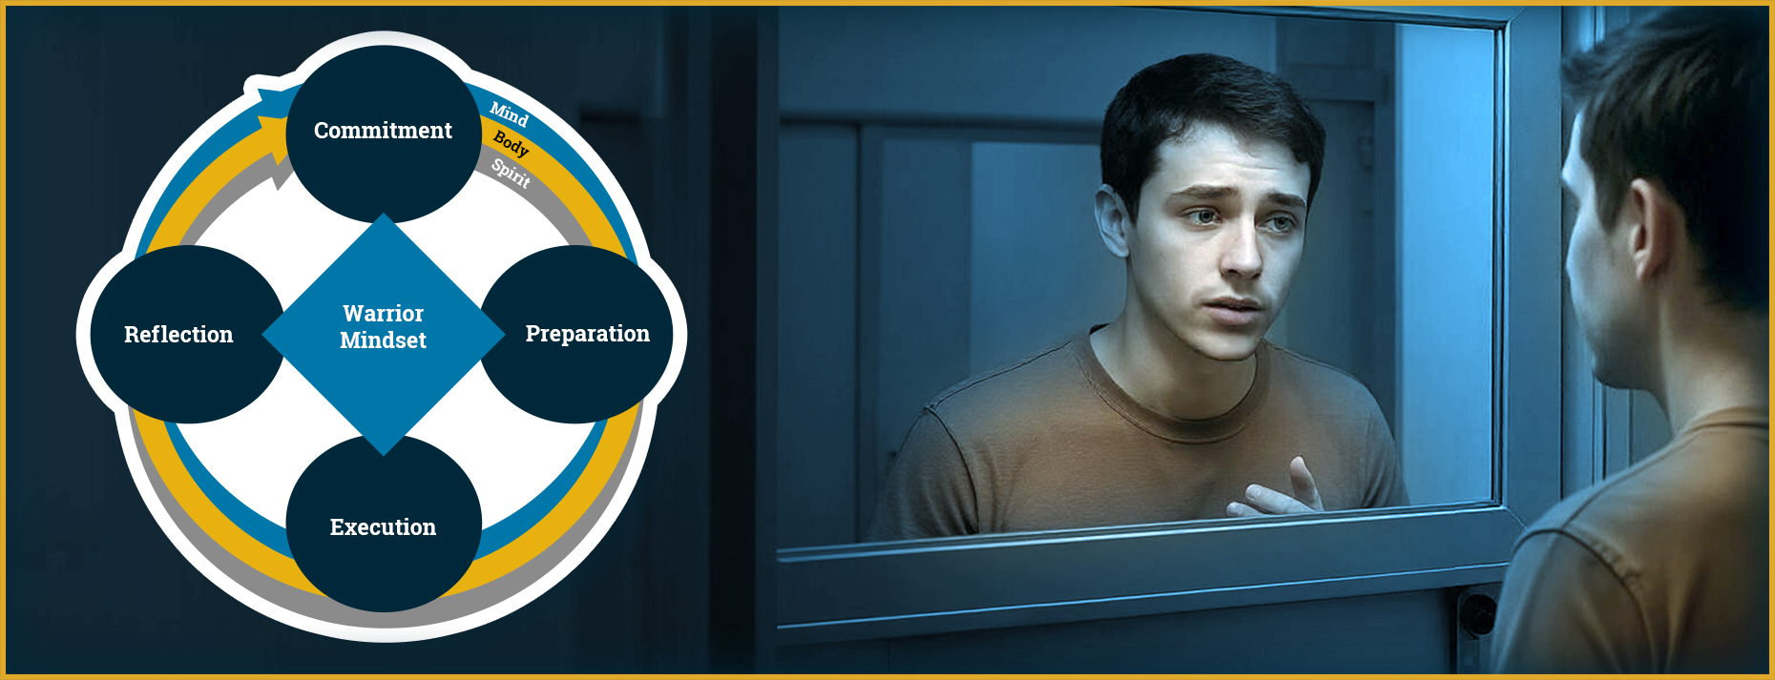
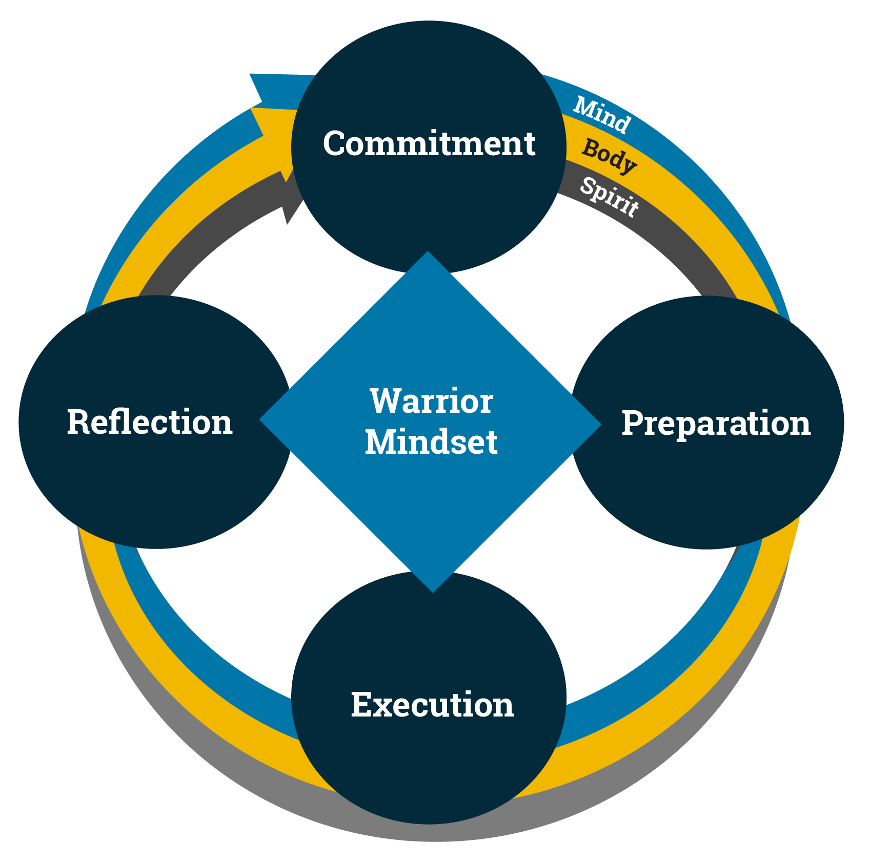
Self-Talk and the Warrior Mindset
How do performance statements use self-talk?
Notes:
Facilitator Actions:
Display slide.
Discuss how graphic relates to topic.
Monitor the discussions of the Sailors.
Facilitator Content:
Inform:
Commit to optimizing your performance in high-stress situations by being aware of self-talk.
Prepare by practicing and using positive self-talk in pre-determined performance statements.
Execute by implementing prepared performance statements to stay focused when it’s time to act.
Reflect on your performance by recognizing self-talk and examining both strengths and areas to improve.
Discuss:
How do performance statements use self-talk?

Slide 8
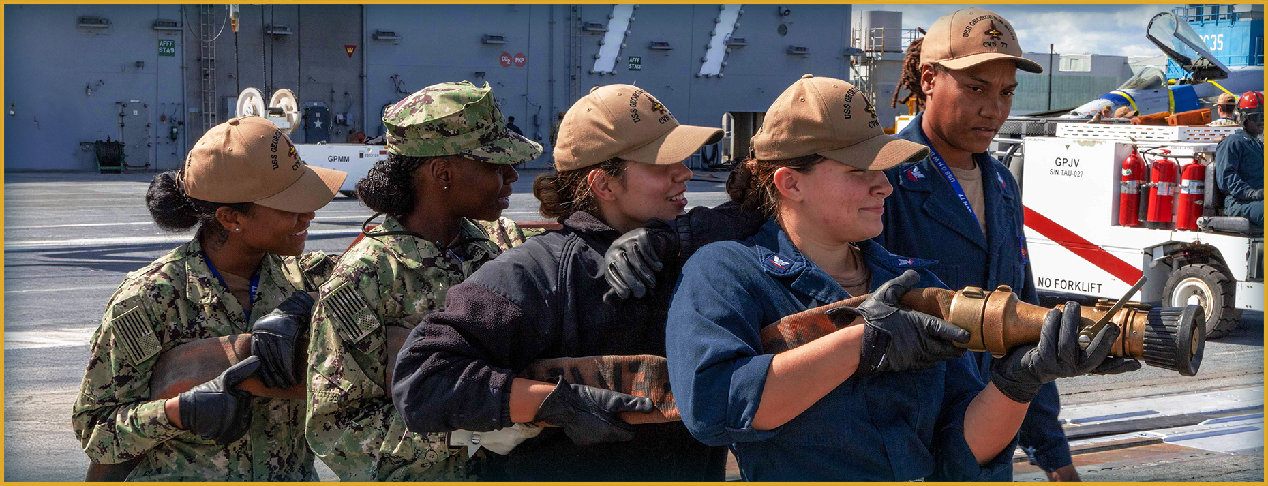
Performance Statements Activity
Where might you utilize performance statements as a tool at your command?
Notes:
Facilitator Actions:
Display slide.
Monitor the discussions of the Sailors.
Allotted time for activity: 5 minutes.
Facilitator Content:
Expected outcome: Sailors will create performance statements that are brief, instructive, realistic, and helpful.
Inform:
Practice using performance statements to control your environment.
Discuss:
This exercise asks questions about performance statements and has the Sailors practice them.
Ask the following:
Where might you utilize performance statements as a tool at your command?
What are some ways you might develop appropriate performance statements?
Perform:
Have the Sailors take turns practicing and discussing performance statements.

Slide 9

Call to Action
Practice appropriate performance statements and stay in the fight!
Notes:
Facilitator Actions:
Display slide.
Review topics discussed and ask if there are any questions.
Check Sailor comprehension by providing review questions and/or problems.
Discuss how the call to action supports and encourages Sailors’ post training.
Relate call to action to Warrior Toughness.
Facilitator Content: N/A

Slide 10
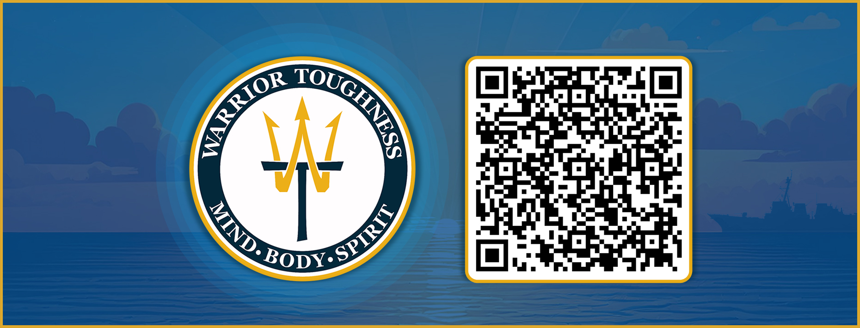
Warrior Toughness QR Code
Notes:
Facilitator Actions:
Display slide.
Facilitator Content:
Inform:
Identify Warrior Toughness QR code.

Slide 11
References
Tools and Resources
Warrior Toughness Terms
Notes:
Facilitator Actions:
Display slide.
Facilitator Content:
Inform:
Identify tools.
Identify resources.

Slide 12
Glossary
Glossary
Acronym | Term
WT | Warrior Toughness
Notes:
Facilitator Actions:
Display slide.
Facilitator Content: N/A

